Slide 1
IIP mini Project
Group - 6

Slide 2
Work breakdown structure
Clickup.com

Slide 3
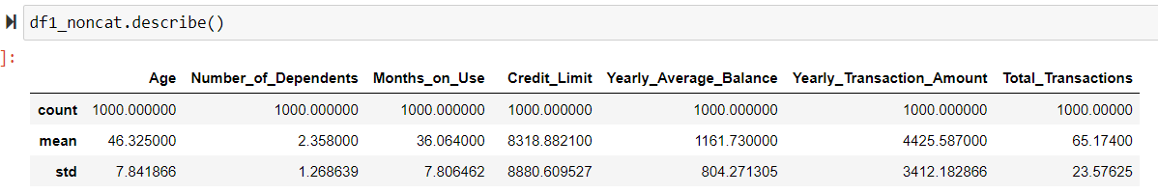
Information on the Dataset/Data Subset
Credit Card Dataset
Variables
Descriptive Variables
Nominal
Quantifying Variables
Nominal Categorical Ordered
Customer Number
Customer Status
Gender
Education
Marital Status
Card Type
Nominal Categorical
Number of dependents
Age Category
Non-Categorical
Categorical
Months on Use
Credit Limit
Yearly Average Balance
Yearly Transaction Amount
Total Transactions
Income Level
DATA SET
No. of columns (Variables) = 14
No. of Rows (Records) = 10127
DATA SUB-SET
No. of columns (Variables) = 14 + 1 (Age Category)
No. of Rows (Records) = 1000 (given)
No. of Null values = 0

Slide 4
Objectives of the Analysis
Data Pre-Processing
Max and min of each category
Average Transaction/customer
Average Value/transaction
Characteristics of the most and the least income contributing segment
Statistical analysis of Yearly Transaction Amount with the card type

Slide 5
Over View Of the Analysis
Step 1
Descriptive statistics of the Categorical variables, consisting of the count and percentage of each category of the variable
Pivots Tables for Income category analysis w.r.t non categorical variables vs age category, marital status, no. of dependents and card category (Used in Dashboard)
Step 2
Step 3
Statistical Analysis of Yearly Transaction amount
Step 4
Cluster Analysis
Step 5
Observations and Managerial Implications

Slide 6
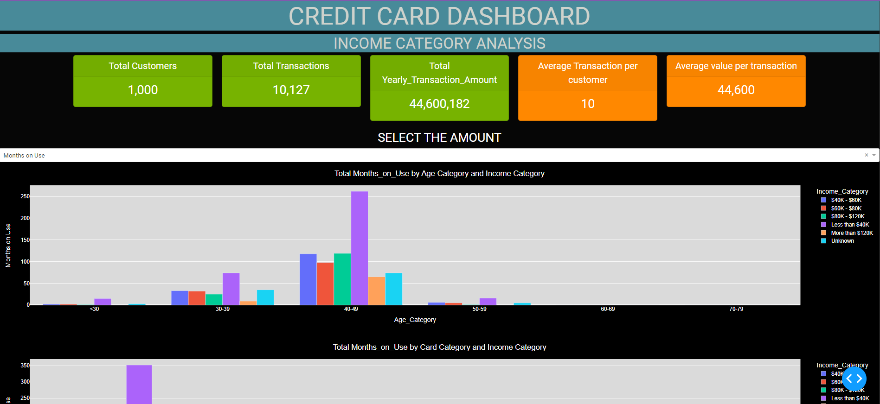

Slide 7
OBSERVATIONs FROM THE ANALYSIS
Minimum and Max of each Category
Income Category Analysis
Statistical Analysis of
Yearly Transaction Amount (YTA)
Gender: 54% Females
Customer Status: 85% existing customer
Education Level: 30% Graduates and 5% doctorate
Marital Status: 44% married, 41% single and 7% divorced
Income Category: 37% <40K and 7% >120k
Card Category: 94% Blue, 1% Gold, 0% Platinum
Age Category: 74% 40-49years
Maximum Income Bringing Segment
Income Category: <40k , Age: 40-49, Card: Blue, No. of dependents:2/3, Marital Status: Married
Least Income Brining Segment
Income category: 60-80k and 80-120k, Age: <30, Card: Platinum/Gold, No. of dependents: 5, Marital Status: Divorced
Kruskal-Wallis test: (29.617, p-value 1.66e-06). We reject the null hypothesis and conclude that there at least one of the card categories that has a significantly different median YTA
Multiple regression: 0.04 p-value for the Gold and silver category indicates that there is a statistically significant difference in the mean YTA between Blue and Gold categories and Blue and silver category, holding all other variables constant
Notes:
Regression Eq: Yearly Transaction amount = 3852.11 + 2314.44(Card_category.gold) + 3054.9345(Card_category.silver) + 0.049(Credit_Limit)

Slide 8
MANAGERIAL IMPLICATIONS
CUSTOMER FOCUS
CARD CATEGORY FOCUS
1. Attract more male customers and retaining existing customer
2. Target high-income segment (>120k)
​3. Target 30% graduates and 5% who are doctorates, as they are likely to have high-income potential in the future
1. Increasing its market share in the gold and platinum card
2. The company should focus on the gold category​
By providing
Excellent customer service
Personalized offers
Loyalty rewards
Student credit cards, educational loans
Higher credit limits
Services tailored to the needs of this segment

Slide 9
THANK YOU

Slide 10
Observations from the Analysis
​ | Age Category |  | Card Category |  | Number of Dependents​ |  | Marital Status
 | Max | Min | Max | Min | Max | Min | Max | Min
Months on Use | IC(<40k) 40-49 262 | IC(40-80k) <30 3 | IC(<40k) Blue 352 | IC(60-80k) Gold 3 | IC(<40k) 3 96 | IC(60-80k) 5 1 | IC(<40k) Married 161 | IC(80-120k) Divorced 5
Credit Limit | IC(80-120k) 40-49 1.78M | IC(un) <30 13k | IC(80-120k) Blue 1.94M | IC(40-60k) Gold 22k | IC(80-120k) 3 659k | IC(60-80K) 5 7411 | IC(80-120k) Married 951k | IC(40-60k) Unknown 38k
Yearly Transaction Amount | IC(<40k) 40-49 1.18M | IC(40-60k) <30 12k | IC(<40k) Blue 1.5M | IC(>120k) Platinum 8012 | IC(<40k) 2 448k | IC(60-80k) 5 4278 | IC(<40k) Married 688k | IC(80-120k) Divorced 26k
Total Transactions | IC(<40k) 40-49 17k | IC(un) <30 94 | IC(<40k) Blue 23k | IC(60-80k) Platinum 104 | IC(<40k) 2 6425 | IC(60-80k) 5 80 | IC(<40k) Married 10k | IC(80-120k) Divorced 342
Notes:
Bringing Maximum Income
Income Category: <40k
Age: 40-49
Card: blue
Marital Status: Married
No.of dependents:2
Bringing Least Income
Income category: 60-80k and 80-120k
Age: <30
Card: Platinum
No. of dependents: 5
Marital Status: Divorced

Slide 11
The company should focus on attracting more male customers as only 46% of the customers are male. By offering promotions and customized offers to male customers, the company can increase its customer base and revenue.
The company should focus on retaining its existing customers as they constitute 85% of the customer base. By providing excellent customer service, personalized offers, and loyalty rewards, the company can retain its existing customers and ensure repeat business.
The company should target the high-income segment (>120k) by offering premium credit card services and personalized offers to this segment. This can help the company increase its revenue and profitability.
The company should also target the 30% of customers who are graduates and 5% who are doctorates, as they are likely to have high-income potential in the future. By offering student credit cards, educational loans, and other financial products tailored to this segment, the company can increase its market share.
The company should focus on increasing its market share in the gold and platinum card categories, which currently have a low market share of 1% and 0%, respectively. By offering exclusive benefits, higher credit limits, and personalized offers, the company can attract more customers to these categories.
Based on the Kruskal-Wallis test, the company should conduct further analysis to identify the card categories that have a significantly different median YTA. By identifying the card categories with the highest YTA, the company can focus its marketing efforts on these categories to increase revenue.
Based on the multiple regression analysis, the company should focus on the gold category, which has a statistically significant difference in the mean YTA compared to the blue category, holding all other variables constant. By offering exclusive benefits and personalized offers to gold cardholders, the company can increase its revenue from this segment.
The company should also focus on the maximum income-bringing segment, which consists of customers with an income category of <40k, aged between 40-49 years, with 2-3 dependents, and are married. By offering customized offers, loans, and credit card services to this segment, the company can increase its market share and revenue.
Finally, the company should also focus on the least income-bringing segment, which consists of customers with an income category of 60-80k and 80-120k, aged below 30, with 5 dependents, and are divorced. By offering personalized offers and credit card services tailored to the needs of this segment, the company can increase its market share and revenue.

